Slide 2
Business Intelligence
S.Rakesh
Assistant Professor
IT Department
srakesh_it@cbit.ac.in

Slide 3
Data
011100110111010101111001100001010101100101010111010101010111001110000100

Slide 4
Processing
Divide the given data into group of 8 bits.
Binary → Hexa Decimal → ASCII Character
011100110111010101111001100001010101100101010111010101010111001110000100

Slide 5
Processing
01110011 01110101 01111001 10000101 01011001 01010111 01010101 01110011 10000100

Slide 6
Processing
01110011 01110101 01111001 10000101 01011001
73 76 79 86 69
01010111 01010101 01110011 10000100
67 66 73 84

Slide 7
Processing
01110011 01110101 01111001 10000101 01011001
73 (I) 76(L) 79(O) 86(V) 69(E)
01010111 01010101 01110011 10000100
67 (C) 66(B) 73(I) 84 (T)

Slide 8
Information
I LOVE CBIT
Data → →Information
Processing
(Software Tools)

Slide 9
BI Syllabus
Overview of syllabus

Slide 10
Introduction
Definitions:
Business intelligence (BI) is a process for analyzing data and presenting the information which helps executives, managers and other corporate end users make informed about business decisions.
Information technology which provides decision makers with valuable information and knowledge by leveraging a variety of data sources as well as structured and unstructured information.
Data sources external or internal to the organization
Information quantitative or qualitative
Output: knowledge
Input: information and data

Slide 11
Introduction
BI has wide variety of tools, applications and methodologies.
Using BI, organizations can collect data from internal systems and external sources, prepare it for analysis, develop and run queries against that data and create reports, dashboards and data visualizations to make the analytical results to make decisions

Slide 12
Objective of BI
The objective of business intelligence is to analyze raw data, and based on that assessment, provide information regarding business activities. Business intelligence can help companies and their employees to undertake future steps based on current, past and predictive information about an organization's operations.

Slide 13
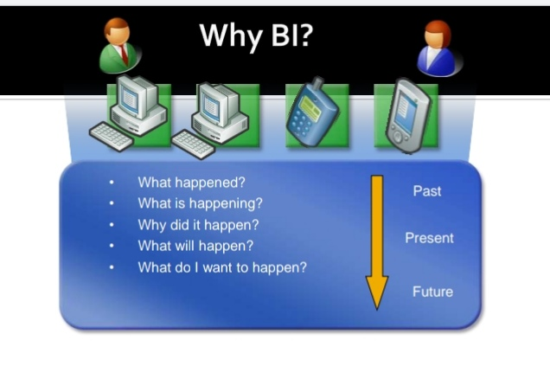

Slide 14
Importance of BI
BI is to improve all parts of a company by improving access to the firm's data and then using that data to increase profits
Data collected is converted into business processes. So business decisions can be made on data to increase productivity, revenue and growth
Improving decision-making
Assisting companies in the identification of market trends
Spotting business problems that need to be addressed

Slide 15
What exactly BI will do?
BI data includes historical information stored in a data warehouse, as well as new data gathered from source systems as it is generated, enabling BI tools to support both strategic and tactical decision-making processes.

Slide 16
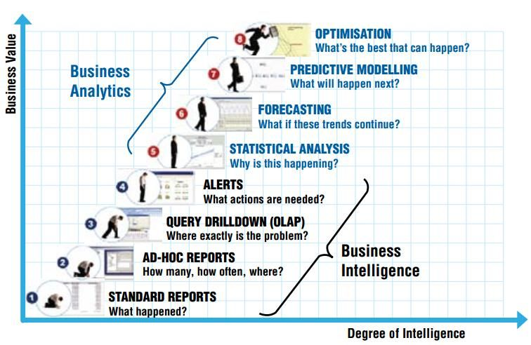
Degree of Intelligence Vs Business Value

Slide 17
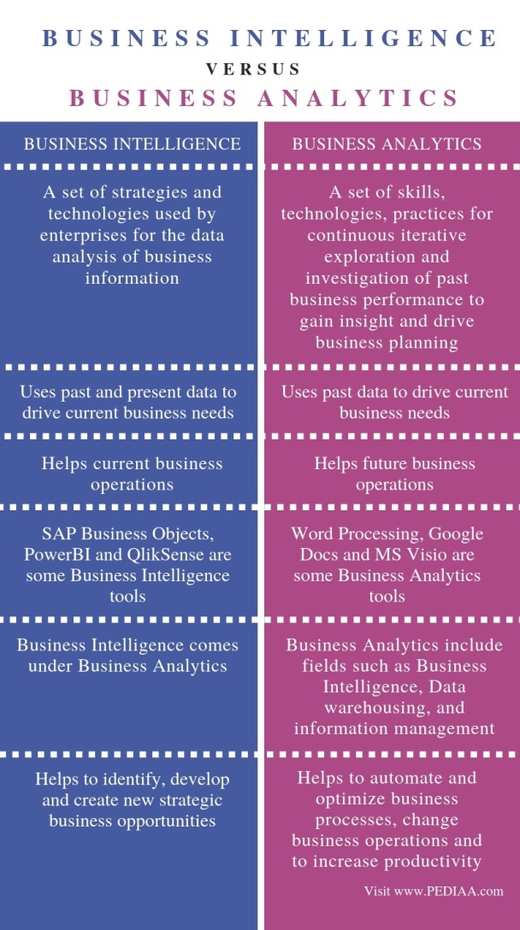

Slide 18
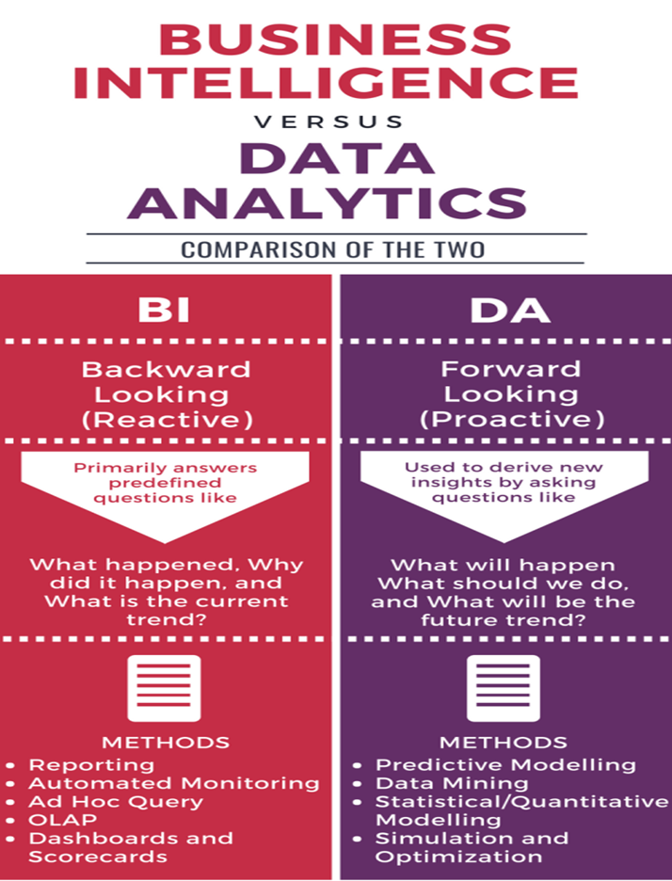

Slide 19
BI Tools
SAP Business Intelligence
MicroStrategy
Datapine
SAS Business Intelligence
Yellowfin BI
QlikSense
Zoho Analytics
Microsoft Power BI
Tableau ..etc

Slide 20
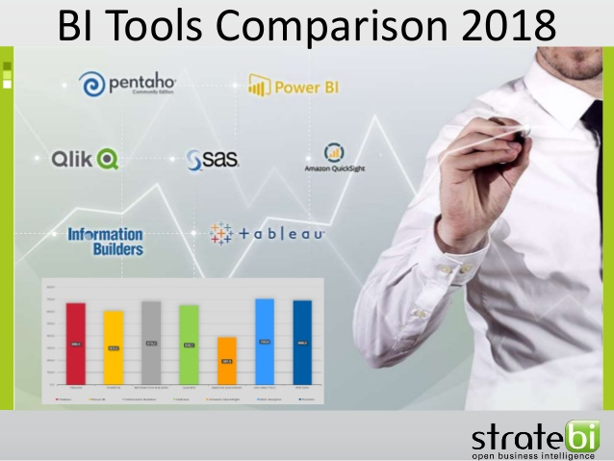
BI Tools

Slide 21
Overview of Today’s Session
Syllabus Overview
What is BI?
Why BI?
Importance of BI.
Business Value vs Degree of Intelligence.
Business Intelligence vs Business Analytics.
BI Tools.

Slide 22
Queries ……?
Yasya Nasthi Swayam Pragna
Tasya Gnanam Karishyathi Kim
Lochanabhyam Viheenasya
Darpanam Kim Karishyathi.
(Always Learn New Things)

Slide 23
Chapter 1: Business Intelligence and its Impacts

Slide 24
Topics
Introduction
Information Pyramid-Data, Information, and Knowledge
What is BI
Factors driving BI
BI and Related Technologies
BI in contemporary organizations
Obstacles to Business Intelligence

Slide 25
Business Intelligence – A Highly Important Field
Benefits
Management effectively aided
Intellectual capital better deployed
Business operations improved
Customer service enhanced
New opportunities identified

Slide 26
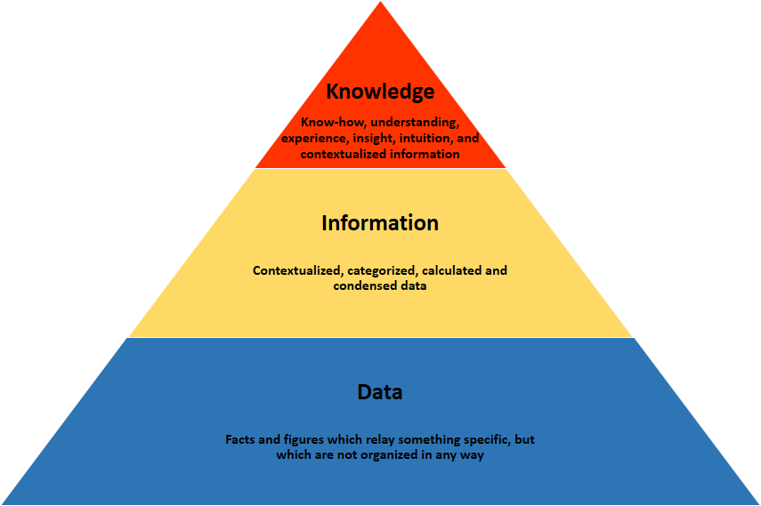
Information Pyramid

Slide 27
Data, Information, Knowledge
Data
May or may not be correct
Ex. Sales order at a restaurant included a large burger, medium fries and milkshake
Information
Subset of data
Data possessing context, relevance, and purpose
Ex. The numbers indicating the daily sales (in dollars, quantity, etc.) of burgers, fries, vanilla milkshakes
Knowledge
Justified beliefs about relationships among concepts
Ex. The relationship between the quantity of bread that should be ordered, the quantity of bread in inventory, and the daily sales of burgers and other products that use bread.

Slide 28
Data, Information, Knowledge, and Decisions
Raw facts, observations, or perceptions
Data that has been processed so as to have context, relevance, and purpose
Decisions
Data
Justified beliefs about relationships relevant to the decision
Information
Knowledge
Analyze
Interpret
Apply

Slide 29
What is Business Intelligence (BI)?
Information technology which provides decision makers with valuable information and knowledge by leveraging a variety of data sources as well as structured and unstructured information.
Data sources external or internal to the organization
Information quantitative or qualitative
Output: knowledge
Input: information and data

Slide 30
Quantitative Vs Qualitative
Quantitative data are measures of values or counts and are expressed as numbers.
Quantitative data are data about numeric variables (e.g. how many; how much; or how often).
Qualitative data are measures of 'types' and may be represented by a name, symbol, or a number code.
Qualitative data are data about categorical variables (e.g. what type).

Slide 31
Example
Suppose we have chronicled data of a Shopping Mart of 3-6 months. Here, in the data we have different products with their respective specifications. Let us select one of the products-say Candles. We have three kinds of Candles in this class say Candle A, Candle B, Candle C. On studying of these data we come to know that sale of Candle C was at peak out of these three classes. Now on afresh and deep study into these data we got the outcome that the sale of this Candle C was maximum between the time intervals of 9 am to 11 am. On further deeper analysis, we came to the conclusion that this specific Candle is the one used in place of worship.

Slide 32
Example Contd..
Now, let’s apply Business Intelligence for this analysis. What an enterprise firm or the organization can do is, get other material that can be used in church and place them nearby those candles. Now the customers approaching the Shopping Mart to purchase the candles for place of worship can also have a look on the other material and may be tempted to purchase them as well. Now this will surely enhance the sales and hence the income of Shopping Mart.

Slide 33
BI Product, Process, Solution, and Tools
BI Product
Data and Information (External & Internal; Structured & Unstructured)
BI Process
Information (that leads to knowledge and/or enables decision making)
BI Solution
Other Technologies (e.g., Data Warehouse, Data Mining)
BI Tools

Slide 34
Factors driving BI
Exploding data volumes
Increasingly complicated decisions
Need for quick reflexes
Technological Progress

Slide 35
Factors that drive BI
Exploding data volumes
Cheaper storage
More electronic connections (Internet, intranet,…)
Regulatory changes (Sarbanes Oxley Act 2002)
BI solutions provide managers the ability to more effectively utilize these larger data volumes

Slide 36
Factors that drive BI
Increasingly complicated decisions
Multi-industry, global competition
Decisions from structured and unstructured data
BI solutions provide managers the ability to make decisions that incorporate all the important factors and are based on integration across the information.

Slide 37
Factors that drive BI
Need for quick reflexes
Faster pace of change (volatility)
Windows of opportunity close rapidly
Overcome processing delays
Converting data from variety of sources
Integrating information across sources
Making the results available to the decision maker
BI solutions help address each of the three types of delays.

Slide 38
Factors that drive BI
Technological Progress
Decision Support Systems (DSS)
Enterprise Resource Planning Systems (ERPS)
Data warehousing
Data mining
Text mining
BI vendors have the necessary inputs for developing effective BI tools, and organizations adopting them have the platform to make BI solutions most effective

Slide 39
BI vs KM
Knowledge Management (KM)
Inputs
Information
Knowledge
Output
Creation of new knowledge
Conversion to another form of knowledge
Application of knowledge in making a decision
Business Intelligence (BI)
Inputs
Data
Information
Output
Information presented in a friendly fashion
New knowledge or insight

Slide 40
Roles of Data, Information, and Knowledge in Business Intelligence
Business Intelligence
Only Explicit (but not Tacit) Knowledge
Decisions
Data
Information
Knowledge

Slide 41
Roles of Data, Information, and Knowledge in Knowledge Management
Knowledge discovery in data and information; potential overlap between BI and KM
Knowledge Management
Both Explicit and Tacit Knowledge
Decisions
Data
Information
Knowledge

Slide 42
BI is not data warehousing, data mining nor decision support systems
Data warehouse
A single logical repository for an organizations data
Data mining
The process of discovering hidden patterns from data stored electronically (ex. in a data warehouse)
Decision support systems
Use data as input along with prior knowledge to create rules that guide decisions
Business Intelligence
Presents information to individuals with little technical expertise

Slide 43
Roles of Data, Information, and Knowledge in Data Warehousing
Structured data, primarily internal
Data Warehousing
Data
Information
Knowledge
Decisions

Slide 44
Roles of Data, Information, and Knowledge in Data Mining
Data Mining
Data
Information
Knowledge
Decisions

Slide 45
Roles of Data, Information, and Knowledge in Decision Support Systems
Either support for decision making (DSS) or automation of decision making (Automated Decision Systems)
Decision Support System
Data
Information
Knowledge
Decisions
Knowledge embedded as rules within the system

Slide 46
Four Contributions of BI
Dissemination of user-friendly, real-time information
Creation of new knowledge based on the past
Responsive and anticipative decisions
Decision-making based more closely on all the latest information
Incorporate predictions regarding the future
Improved planning for the future
More effective use of information
Use of past data for predictions about the future
Development of knowledge based on information about the past

Slide 47
Three Benefits of BI to Organizational Success
Improvement in operational performance
Provide real-time information on how performing
Help make organizations more efficient
Improvement in customer service
Improve quality of customer service provided
Identify problems and potential solutions quickly
Reduce customer concerns and improve retention
Identification of new opportunities
Facilitate new insights through discover of unknown patterns
Track innovative projects more effectively

Slide 48
Impacts of Business Intelligence
Dissemination of real-time information in user-friendly format to a variety of users
Enablement of responsive and anticipative
decisions
Improved operational
performance
Business Intelligence
Improved
customer service
Facilitation of new knowledge based on the new insights in information
Improved planning for the future
Identification of
new opportunities

Slide 49
Recap
We have:
Discussed some of the basics of BI
Distinguished among data, information, and knowledge
Explained what BI is and how it differs from other information technologies
Discussed the factors driving the importance of BI
Examined some direct effects of BI and looked at its impacts on organizational performance

Slide 50
Key Terms
business intelligence
data
data mining
data warehouse
decision support systems
information
knowledge
knowledge management
organizational impacts

Slide 51
Chapter 2: Business Intelligence Capabilities

Slide 52
Outline
Four key capabilities of BI solutions
Organizational Memory Capability
Information Integration
Insight Creation
Presentation
We will discuss
Each capability
Factors necessitating each capability
Technologies enabling each capability
Case Studies

Slide 53
Organizational Memory Capability
The ability to store
information and knowledge

Slide 54
Factors Necessitating Organizational memory Capability
Technological progress and Storage costs
Increased use of Internet(e-mail and other e-media)
Pervasiveness of computers for creating and modifying documents and presentations
Improvements in knowledge management technologies

Slide 55
Technologies enabling Organizational memory Capability
Transactional systems
Enterprise Resource Planning Systems(ERPS)
Data Warehouses
Document management systems
Knowledge repositories
Digital content management systems

Slide 56
Information Integration Capability
The ability to link
structured and unstructured data
from
a variety of sources

Slide 57
Factors Necessitating Information Integration Capability
Structured data and information (often incompatible)
Data outside operational systems (e-mail, audio, video ..etc)
External data (public data, industry reports, experts opinions ..etc)
Increasing decision complexity

Slide 58
Technologies enabling Information Integration Capability
Environmental scanning
Web mining
Text mining
Radio frequency identification devices (RFID)

Slide 59
Insight Creation Capability
The ability to develop new insights
and
use them in the short-term or long-term
to make better decisions

Slide 60
Factors Necessitating Insight Creation Capability
The need for quick reflexes
Increasing domain complexity

Slide 61
Technologies enabling Insight Creation Capability
Data mining
Business Analytics
Real time decision support

Slide 62
Presentation Capability
The ability to use appropriate reporting and balanced scorecards tools,
and
thereby make BI more valuable to users

Slide 63
Factors Necessitating Presentation Capability
Role (CEO, Managers, operational-level workers)
Task
Preferences

Slide 64
Technologies enabling Presentation Capability
OLAP
Visualization
Digital dashboards
Scorecards
Corporate performance management

Slide 65
Four Synergistic Business Intelligence Capabilities
Users
Information presented in user-friendly fashion and in ways most appropriate for each user
Presentation
New insights and information to support decision making in a real-time fashion
Insight Creation
Synthesized information about the past and present (structured and unstructured, external and internal)
Information Integration
Historical information and explicit knowledge accumulated over time (mainly structured and internal)
Organizational Memory

Slide 66
Three Categories of Features
BI capabilities support features of BI solutions which are classified into 3 broad categories related to capabilities
Benchmarking
Relative to competition and industry trends
Intelligence
Ability to search and utilize data across disparate sources
Convenience
Customization and connectivity

Slide 67
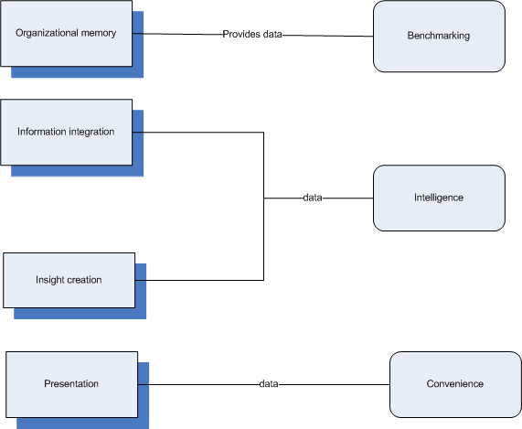
Relation of Categories to Capabilities

Slide 68
Why Information Integration Capability?
Mutually disconnected, incompatible transactional systems exist within an organization
Data exists outside of transactional systems such as e-mail, audio and video files, etc.
A lot of relevant external data is available, such as web sites, industry reports, expert opinions
More complex decision making due to an increase in the diversity of factors to consider

Slide 69
Information Integration Capability
External information and knowledge from environmental scanning and web mining
External
Unstructured information and knowledge from text mining, web mining and digital content management systems
Source of Content
Both past content as well as emergent, real-time content needs to be integrated in each situation
Internal
Structured
Unstructured
Nature of Content
Structured information and explicit knowledge from ERP systems, transactional systems, and knowledge repositories

Slide 70
Why Insight Creation Capability?
Need quick reflexes
Decisions must be made quickly to be competitive
Domain complexity is increasing
Must consider information from diverse arenas

Slide 71
Insight Creation Capability
Insight creation or Learning
Impacts of Insight Creation Capability
Real-time Decision Making
Describe What Happened
Understand What Happened
Predict What Will Happen
Outputs of Insight Creation Capability
Note: The relative sizes of the boxes in the above cells represent the relative magnitudes of impacts of insight creation capability on real-time decision making and insight creation or learning.

Slide 72
Why Presentation Capability?
Content and format needs differ
Role
Ex. Top executive interest in firm-level performance vs. customer-support personnel interest in aids that support real-time responses to customers
Task
Ex. Customer-support specialist uses different information for each task
Preference
Ex. Individuals differ: Big picture view vs details first

Slide 73
Factors Affecting Presentation
Role
Content
Task
Format
Presentation
Preference

Slide 74
Presentation Capability Technologies
Goal: Maximize learning and decision making
Online Analytical Processing (OLAP)
Explore and analyze interactively
Visualization
A picture is worth a thousand words
Digital Dashboards
Display metrics in customizable interface and navigable layout
Scorecards
Monitor and show performance

Slide 75
Inputs and Outputs of the Four Business Intelligence Capabilities
Users
Information presented in user-friendly fashion and in ways most appropriate for the specific role, task, and situation
Presentation
Roles, tasks, and users’ inputs regarding preferred nature of presentation
New insights and information to support learning and real-time decision making
Insight Creation
Users’ inputs about the analyses that may be appropriate
Synthesized information about the past and present (structured and unstructured, external and internal)
Information Integration
Real-time data,
Unstructured Information, External Information
Historical information and explicit knowledge accumulated over time (mainly structured and internal)
Organizational Memory
Data, information, explicit knowledge (mainly internal, structured) stored in systems as events occur

Slide 76
Technologies Enabling Business Intelligence Capabilities
Presentation
OLAP
Visualization
Digital Dashboards
Scorecards
Business Performance Management
Creation of Insights
Data Mining
Business Analytics
Real-time Decision Support
Information Integration
Environmental Scanning
Text Mining
Web Mining
Radio Frequency Identification Devices
Organizational Memory
Data Warehousing
Enterprise Resource Planning
Knowledge Repositories
Digital Content Management Systems
Document Management Systems

Slide 77
Queries…..?
Case Studies
Bahama’s tourism industry (Organizational memory )
Cablecom (Information Integration)
PhoneWorks (Insight Creation)
Continental Airlines (Presentation)

Slide 78
Organizational Memory Helps Bahamas' Tourism Industry
Bahamas' Ministry of Tourism contracted with Indusa Global to help select and implement a business intelligence solution.
Actuate Corporation
immigration cards on arrival and postvisit satisfaction data on departure
the increase in organizational memory through the collection and storage of this data has also provided the country with intelligence in predicting future visitor trends and helping it to develop visitor programs through incentive-based, personalized, multichannel marketing.

Slide 79
Bahama’s tourism industry…
The organizational memory capability of BI serves as the basis for several reports for industry partners.
According to the Hon. Obie Wilchcombe, Minister of Tourism of the Bahamas: ''Technology is transforming the tourism industry and the Ministry of Tourism intends to be in the forefront of that transformation.”

Slide 80
Bahama’s tourism industry….
Prior to BI, even though the Bahamas had a lot of tourist data from the required visitor immigration cards, it was not very accessible. But BI has enabled the government and hoteliers to better understand visitors and develop unique marketing programs to increase tourism.
Indeed, the new BI system is helping the Bahamas break tourism records. More than 5 million individuals visited the country in 2005, and spent over $2 billion two new records for Bahamas' Ministry of Tourism.

Slide 81
Information Integration Helps Cablecom Improve Client Satisfaction
Cablecom is the largest cable network operator in Switzerland, with 1,500 employees.
cable television, broadband Internet access, and telephone services.
Despite being a market leader, Cablecom faced challenges. Before 2005, its marketing efforts focused on acquiring customers, but paid little attention to customer retention.

Slide 82
Cablecom…
Federico Cesconi, Cablecom's director of business intelligence, remarked: ''It's very difficult to win back customers after they've left you. And in Europe, the win-back rate is only about 10% to 15%. So, our intent was to assess the satisfaction of every single customer.'

Slide 83
Cablecom…
After going through an extensive software evaluation process, Cablecom' s customer insight and retention team shortlisted two candidates, and then selected software from the Chicago-based SPSS, Inc., due to its ability to integrate the various customer data sources.

Slide 84
Cablecom…
The SPSS customer analytics software accesses behavioral data from multiple sources managed within Cablecom's Oracle data warehouse, including data from the call center, call detail record data, demographic data, and externally bought data. More than 60 criteria are used to analyze customers.

Slide 85
Cablecom…
Cesconi indicated that after six months of use, Cablecom's new approach successfully identified dissatisfied customers and increased satisfaction in 53% of all cases.
Cablecom's excellent customer service was recognized in September 2008, when the company received the ''Gartner & ltol Gold Award for Excellence in Customer Strategy."

Slide 86
Insight Creation Capability at PhoneWorks
PhoneWorks is a professional services firm that assists organizations in developing and implementing sales strategies through the creation of new inside sales teams or the optimization of existing inside sales groups.
It has considerably enhanced its insight creation capability through the use of a sales analytics-as-a-service solution from LucidEra.

Slide 87
PhoneWorks …
Prior to the use of LucidEra's sales analytics solution, PhoneWorks' use of Salesforce.com
Salesforce.com provided a comprehensive view of the current business situation through static reports.
average deal size and average days to close

Slide 88
PhoneWorks …
PhoneWorks discovered new insights into its business through the BI solution, especially with respect to how the sales cycle process was progressing from stage to stage.
Earlier, Phone Works had tracked the average time to complete the sales cycle, but with LucidEra, the company was able to see the progression from each stage of the sales cycle to the next, and thereby identify, for example, gaps and any bottleneck within an individual stage or in the overall process.

Slide 89
PhoneWorks …
Sally Duby, the president and chief operating officer of PhoneWorks, remarked: “LucidEra has given us insight into our internal sales process in a simple way that avoids the prohibitive cost, complex deployment cycle, and extensive data warehousing effort that a traditional approach to business intelligence would have required.”

Slide 90
Continental Airlines' Use of Digital Dashboards
Continental Airlines is a large airline with more than 250 destinations worldwide and over 69 million passengers enplaned in 2007. It has received a number of awards over the years, and was named the Best Airline for North American Travel in Business Traveler magazine's 2008 Best in Business Travel Survey.

Slide 91
Continental Airlines …
Continental Airlines has made excellent use of BI's presentation capability. One such use is in the Flight Management Dashboard. This is a set of interactive graphical displays, which together enable the operations staff to quickly identify issues in the Continental flight network and thereby manage flights to enhance customer satisfaction and airline profitability

Slide 92
Continental Airlines …
Convenient access to critical information is accomplished in this BI solution through the use of well-designed graphics tools. For example, a graphical depiction of a concourse shows, for each delayed flight, the number of high-value customers who might need assistance in making their connections to each gate, and the time available for them to catch their flights. If necessary, these customers are ushered to their connections to help them avoid missing flights.

Slide 93
Continental Airlines …
Continuing the use of BI's presentation capability, Continental signed a deal with MicroStrategy in February 2009 that is intended to help improve insight into passenger purchasing habits.
MicroStrategy's reporting tools and dashboards are expected to help Continental's marketing staff to analyze data and spot trends that can be used to develop appropriately timed marketing campaigns

Slide 94
Recap
We have:
Summarized the four main capabilities of BI solutions
Discussed each capability and the factors necessitating it
Examined the interrelationships among these four capabilities
Identified and discussed the technologies facilitating each capability
Understand the case studies w.r.t each BI capability
Discussed Questionaries' related to BI Capabilities

Slide 95
Key Terms
business analytics
business performance management
content
data mining
data warehousing
digital content management systems
digital dashboards
document management systems
enterprise resource planning systems
environmental scanning
information
information integration capability
insight creation capability
knowledge
knowledge repositories
learning
OLAP (online analytical processing)
organizational memory capability
presentation capability
radio frequency identification devices
real-time decision support
scorecards
text mining
transactional systems
virtualization
web mining

Slide 96
Thank you

Slide 97
Chapter 3: Technologies Enabling Organizational Memory

Slide 98
Topics
Data Warehouse
ER Modeling
Dimensional Modeling
Designing Enterprise Architecture
Knowledge Repositories

Slide 99
Organizational Memory, Data Model & Data Type
Organizational Memory
Storage of information in such a form that it can be later accessed and used for BI
Relates to corporate memory, knowledge repository and institutional memory
Data Model
Describes how data is represented and accessed (i.e. provides definition and format of data)
Data Types
Structured Data
Unstructured Data

Slide 100
Organizational Memory Capability
Enterprise Resource Planning (ERP)
Refers to transactional systems that capture organizational memory related to all business processes that the organization engages in
Example: Order to cash captures all the transactions in an organization
Transactional Systems: capture all the relevant information for one accounting period (i.e. month/quarter/year/etc.)
Data Warehouse: provides the source of data and information for business intelligence (BI) analysis

Slide 101
Organizational Memory Technologies
Two relevant technologies for the organizational memory capability
Enterprise Resource Planning (ERP) systems
Data Warehouse

Slide 102
Enterprise Resource Planning Systems (ERP)
ERP Systems are software packages composed of several modules such as human resources, sales, finance, and production, providing a cross-organization integration of data through embedded business processes.
Originated from Manufacturing resource planning or material requirements planning systems (MRP)
Control the aspects of:
Manufacturing
Procurement of materials
Delivery and inventory control
ERP systems- implemented to bring enterprise infrastructure to Y2K compliance

Slide 103
Y2K
Year 2000 Problem
2 digits to represent year (eg. 99,98,90 etc)
99-90=9 years
00-90=-90 years (negative)

Slide 104
Enterprise Resource Planning Systems (ERP)-Benefits
Integrate business processes across the enterprise
Single database for the whole enterprise
Access to real time transactional data
Elimination of costly stand alone legacy systems
Elimination of complexities
Provide the infrastructure for organization to improve management of order fulfillment processes
Integration of different departments working in the organization

Slide 105
(ERP)- Vendors
The top four vendors to date include:
SAP (www.sap.com)
Oracle (www.oracle.com)
Sage (www.sagenorthamerica.com)
Microsoft Dynamics (www.microsoft.com/dynamics)
There are also open source versions of ERP systems, including OpenERP, GNU Enterprise, WebERP, etc.

Slide 106
ERP-Implementation Problems
Large monetary investments
Organizational change
Technical challenges
Operational problems
Integrating ERP into existing legacy systems
Code customization may increase complexity

Slide 107
ERP-Implementation Success
Top management commitment
Strong project management
Team member skills
Team member motivation and dedication
Effective communication
Effective change management

Slide 108
ERP-Conflicts
ERP do not drive innovation
Tie between ERP & BI is that a standardized integrated enterprise infrastructure creates better opportunities for the organization to be more agile and adopt innovation
ERP focuses on commoditization
Standardized infrastructure can focus on using BI to respond with agility to environmental signals

Slide 109
Enterprise Systems-Middleware
Another technology that can be used to create an enterprise system, without the use of ERP systems, is through enterprise application integration (EAI).

Slide 110
Enterprise Systems-Middleware
Enterprise Application Integration (EAI)
EAI can parse, duplicate or transform data from an application to present in an acceptable format
EAI deals with data integration with legacy systems
There is no need to redefine business practices

Slide 111
Data Warehouse
IBM researchers Devlin & Murphy first described the concept of data warehouses (DW)
Copy of transaction data structured for querying and reporting
It is a prerequisite to BI since it helps the organization to obtain value from its data sources by preparing and storing the enterprise data into a repository designed to support decision making.

Slide 112
Data Warehouse- Characteristics
Subject Oriented
Integrated using
Operational databases
Data archives
Legacy databases
External data
Nonvolatile
Time-Variant

Slide 113
DW-Vendors
Oracle
NCR Teradata
Open Source Versions like MySQL

Slide 114
Data Warehouse-Four levels
DW is an architecture that describes the atomic level in the enterprise’s data model, which consists of four levels:
Operational Level
Data Warehouse Level
Data Mart or Departmental Level
Individual Data Level

Slide 115
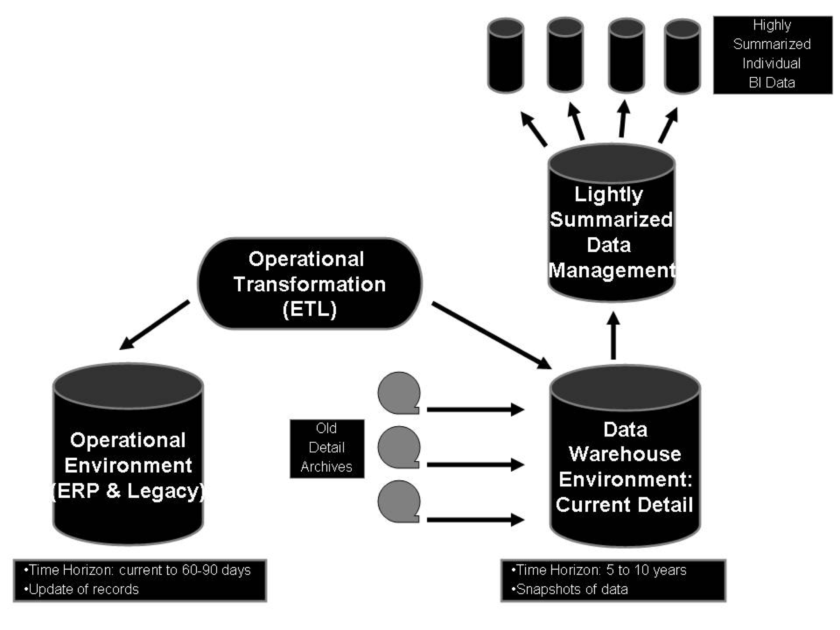
Data Warehouse-Four Levels

Slide 116
Data Modeling Techniques
Entity-Relational (ER) Modeling
Corporate Information Factory (CIF)
Dimensional Modeling
Package Approach

Slide 117
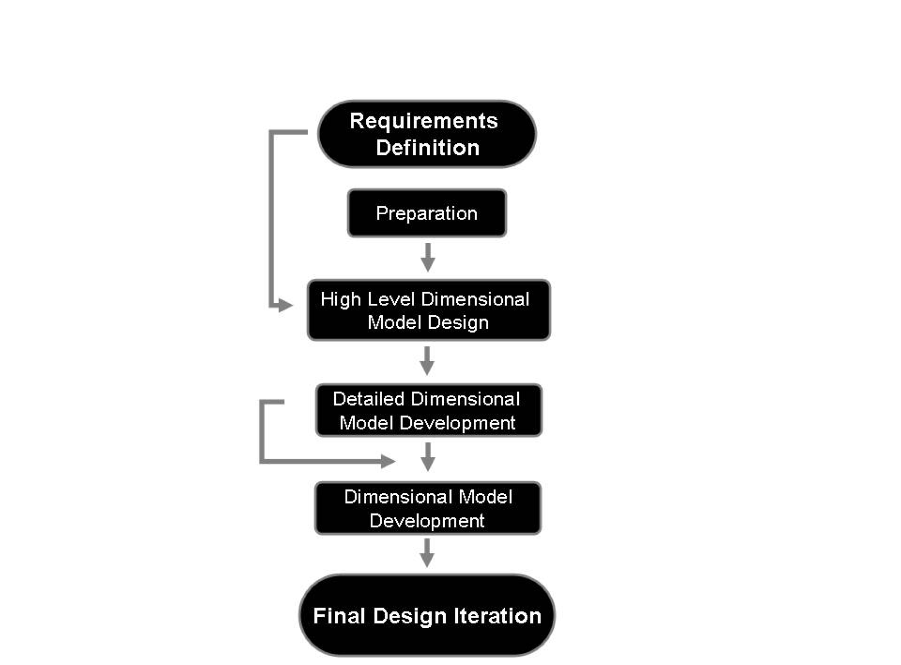
Dimensional Modeling Process Flow Diagram

Slide 118
Technical & Sourcing Challenges
Abundant technical options
Changes in technologies and vendors
Integration requirements
Knowledge transfer challenges

Slide 119
Characteristics of a Mature Data Warehouse
Data
Architecture
Stability of the production environment
Warehouse staff
Users
Impact on users’ skills and jobs
Applications
Cost & Benefits
Organizational impact

Slide 120
University Experts-Searchable Answer Generating Environment

Slide 121
Designing the Enterprise Architecture
Firms define their underlying enterprise architecture by making two important choices about their business operations units:
Standardization
Integration
Refers to the organizing logic for business processes and IT infrastructure reflecting the integration and standardization requirements of the company’s operating model

Slide 122
Operating Models-Based on Standardization and Integration
The Diversification Model (low standardization, low integration )
The Coordination Model (low standardization, high integration)
The Replication Model (high standardization, low integration)
The Unification Model (high standardization, high integration)

Slide 123
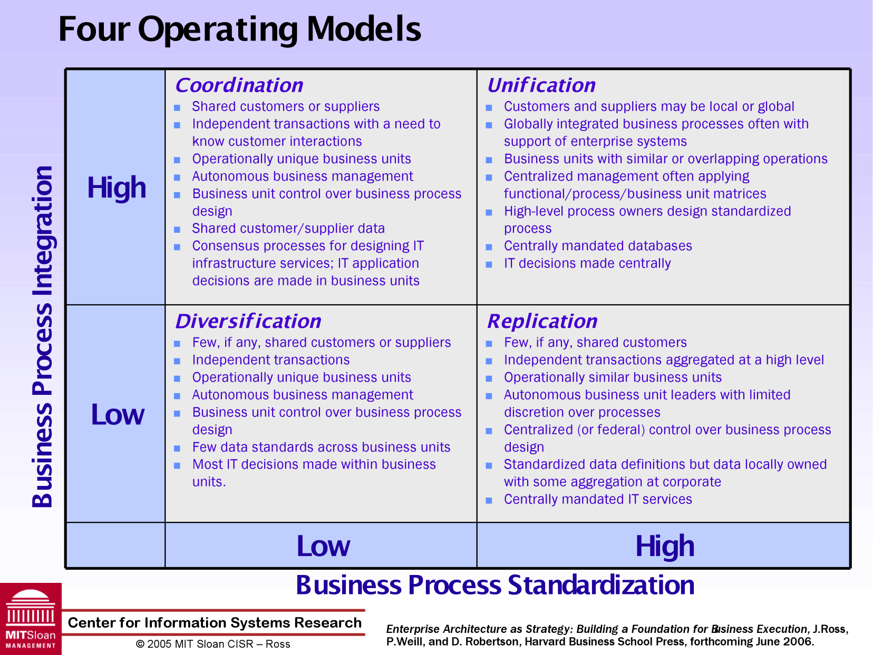
Four Operating Models

Slide 124
Enterprise Architecture
The IT unit typically defines four levels of architecture below the enterprise architecture:
The Business Process Architecture
The Data or Information Architecture
The Application Architecture
The Technology Architecture

Slide 125
Elements of the Enterprise Architecture
Core business processes
Sharing of data driving core processes
Key linking and automation technologies
Key customers

Slide 126
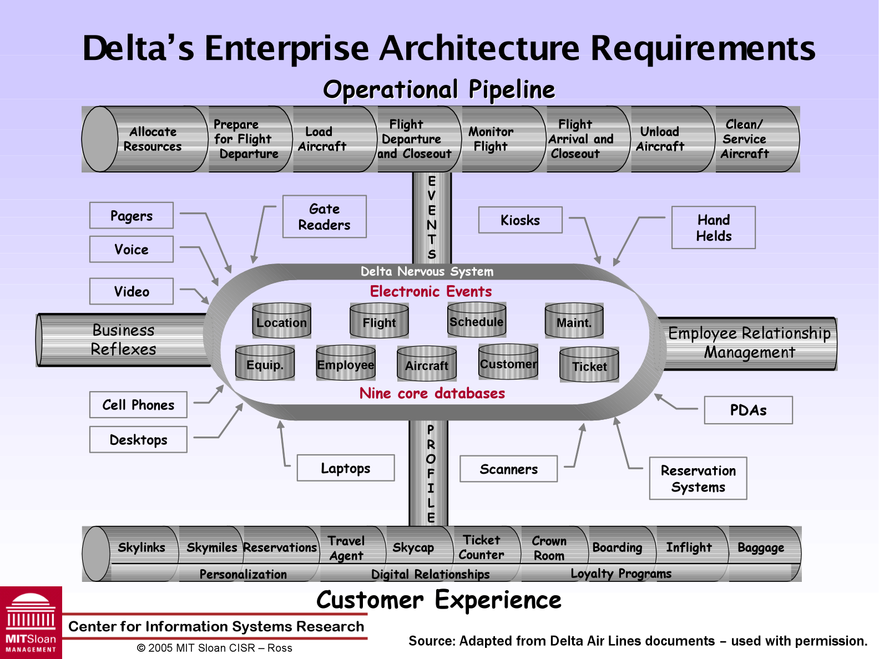
Delta’s Operating Model

Slide 127
Knowledge Repositories
Also known as knowledge sharing systems
Include technologies that support:
Document management systems
Digital content management systems
Enterprise content management systems
Web content management systems

Slide 128
Characteristics of Efficient Knowledge Repositories
Knowledge owners:
Knowledge sharing
Conditions of sharing
Rewarded for knowledge sharing
Knowledge seekers:
Explore possibilities for searching and ranking
Applicability of explicit knowledge
Knowledge sharing and learning

Slide 129
Classification of Knowledge Repositories
Incident Report Databases
Alert Systems
Best Practice Databases
Lessons Learned Systems (LLS)
Expertise Locator Systems

Slide 130
Differentiation of Knowledge Repositories
The differences among the knowledge repositories is based on:
Content origin
Application
Result
Orientation

Slide 131
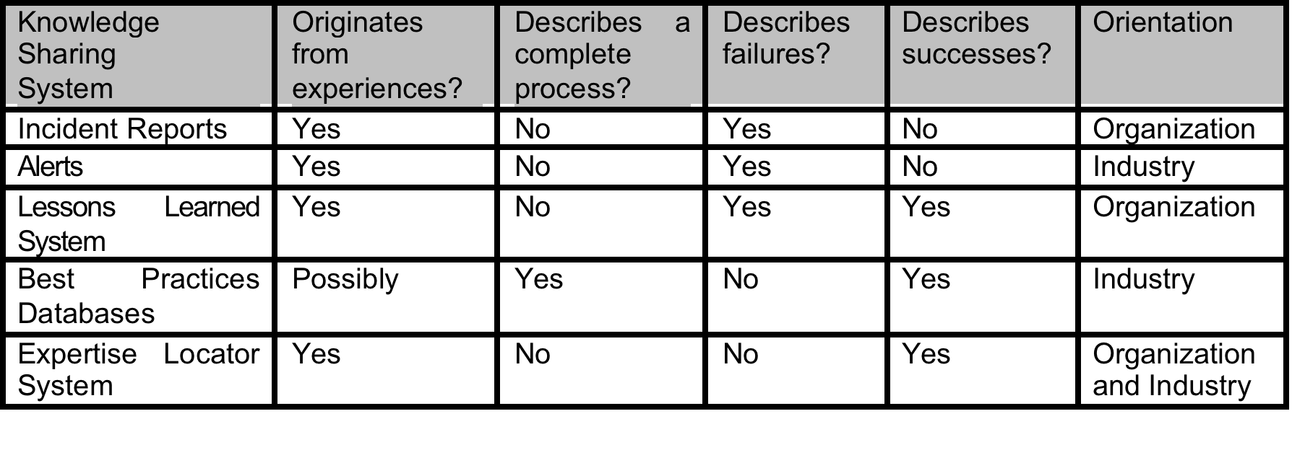
Types of Knowledge Repositories

Slide 132
Dimensional Modeling

Slide 133
A dimensional model is a data structure technique optimized for Data warehousing tools.
It is comprised of "fact" and "dimension" tables.
A Dimensional model is designed to read, summarize, analyze numeric information like values, balances, counts, weights, etc. in a data warehouse.

Slide 134
Elements of Dimensional Data Model
Fact
Facts are the measurements/metrics or facts from your business process.
For a Sales business process, a measurement would be quarterly sales number
Dimension
A dimension is a window to view information in the facts.
Ex: Who, Where, What
Attributes
The Attributes are the various characteristics of the dimension.
In the Location dimension, the attributes can be State, Country, Zip code
Fact Table
A fact table is a primary table in a dimensional model.

Slide 135
Dimension table
A dimension table contains dimensions of a fact.
They are joined to fact table via a foreign key.
Dimension tables are de-normalized tables.
The Dimension Attributes are the various columns in a dimension table
Dimensions offers descriptive characteristics of the facts with the help of their attributes
No set limit set for given for number of dimensions
The dimension can also contain one or more hierarchical relationships

Slide 136
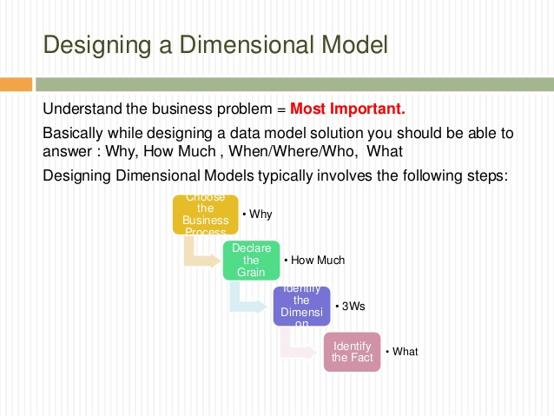
Steps of Dimensional Modelling

Slide 137
Grain
In the world of data warehousing, the grain of a fact table defines the level of detail that is stored, and which dimensions are included make up this grain. Obviously, the higher the grain the better- although source systems and data volume/performance may intervene.
The grain establishes exactly what a single fact table row represents.

Slide 138
Rules for Dimensional Modelling
Load atomic data into dimensional structures.
Build dimensional models around business processes.
Need to ensure that every fact table has an associated date dimension table.
Ensure that all facts in a single fact table are at the same grain or level of detail.
It's essential to store report labels and filter domain values in dimension tables
Need to ensure that dimension tables use a surrogate key
Continuously balance requirements and realities to deliver business solution to support their decision-making

Slide 139
Surrogate key
A surrogate key is a unique identifier used in databases for a modeled entity or an object. It is a unique key whose only significance is to act as the primary identifier of an object or entity and is not derived from any other data in the database and may or may not be used as the primary key

Slide 140
Benefits of dimensional modeling
Easy reporting across areas of the business.
Dimension tables store the history of the dimensional information.
It allows to introduced entirely new dimension without major disruptions to the fact table.
Easier to retrieve the information from the data once the data is stored in the database.
Dimensional table are easier to understand.
Information is grouped into clear and simple business categories.
The dimensional model is very understandable by the business.
Dimensional models are deformalized and optimized for fast data querying.
High performance. It means minimized data redundancy.
The dimensional model also helps to boost query performance.
Dimensional models can comfortably accommodate change.

Slide 141
STAR Schema
In the STAR Schema, the center of the star can have one fact table and a number of associated dimension tables. It is known as star schema as its structure resembles a star.
The star schema is the simplest type of Data Warehouse schema.
It is also known as Star Join Schema and is optimized for querying large data sets.

Slide 142
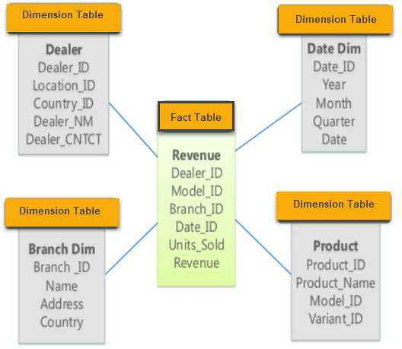
Star Schema

Slide 143
Characteristics of Star Schema
Every dimension in a star schema is represented with the only one-dimension table.
The dimension table should contain the set of attributes.
The dimension table is joined to the fact table using a foreign key
The dimension table are not joined to each other
Fact table would contain key and measure
The Star schema is easy to understand and provides optimal disk usage.
The dimension tables are not normalized. For instance, in the above figure, Country_ID does not have Country lookup table as an OLTP design would have.
The schema is widely supported by BI Tools

Slide 144
SNOWFLAKE Schema
SNOWFLAKE SCHEMA is a logical arrangement of tables in a multidimensional database such that the ER diagram resembles a snowflake shape. A Snowflake Schema is an extension of a Star Schema, and it adds additional dimensions. The dimension tables are normalized which splits data into additional tables.

Slide 145
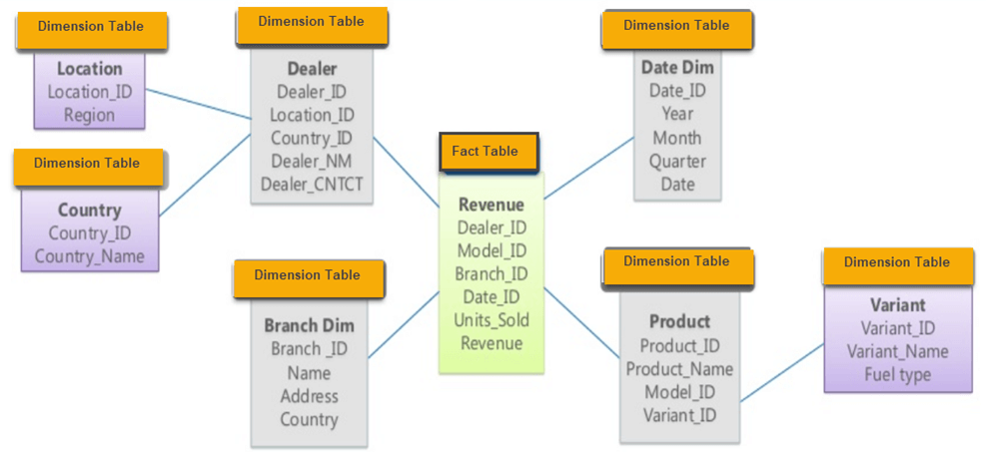
Snowflake Schema

Slide 146
Characteristics of Snowflake Schema
The main benefit of the snowflake schema it uses smaller disk space.
Easier to implement a dimension is added to the Schema
Due to multiple tables query performance is reduced
The primary challenge that you will face while using the snowflake Schema is that you need to perform more maintenance efforts because of the more lookup tables.

Slide 147
Star Vs Snowflake Schema: Key Differences
Star Schema
Snow Flake Schema
Hierarchies for the dimensions are stored in the dimensional table.
It contains a fact table surrounded by dimension tables.
In a star schema, only single join creates the relationship between the fact table and any dimension tables.
Simple DB Design.
Denormalized Data structure and query also run faster.
Hierarchies are divided into separate tables.
One fact table surrounded by dimension table which are in turn surrounded by dimension table
A snowflake schema requires many joins to fetch the data.
Very Complex DB Design.
Normalized Data Structure.

Slide 148
Star Schema
Snow Flake Schema
Very low-level data redundancy
Data Split into different Dimension Tables.
Cube processing might be slow because of the complex join.
The Snow Flake Schema is represented by centralized fact table which unlikely connected with multiple dimensions.
High level of Data redundancy
Single Dimension table contains aggregated data.
Cube processing is faster.
Offers higher performing queries using Star Join Query Optimization. Tables may be connected with multiple dimensions.

Slide 149
The central Repository

Slide 150
central data repository is an aggregation of stored data in some place such that it can be shared, updated, analyzed and secured by every user in an organization.
Advantage of Metadata
One major advantage of metadata is that redundancy and inconsistencies can be identified more easily as the metadata is centralized.

Slide 151
Meta data
Metadata is data about data.
Structural metadata: The creation and specification of data organisations and is more correctly called “data about the containers of data”
Descriptive metadata: Is about one-by-one examples of submission data, the data content.
Example: A webpage may contain metadata identifying what language it is in writing in, what tools were utilised to create it, and where to proceed for more on the subject, permitting browsers to automatically improve the know-how of users.

Slide 152
Metadata (meta content) are characterized as the data providing information about one or more aspects of data, such as:
Means of creation of the data
Purpose of the data
Time and date of creation
Creator or author of the data
Location on a computer mesh where the data were created

Slide 153
Types of Metadata
There are three main types of metadata:
Descriptive metadata describes a resource for purposes such as discovery and identification.
It can include elements such as title, abstract, author and keywords.
Sample elements of it are unique identifiers (PURL, Handle), physical attributes (media, dimensions condition)and bibliographic attributes (title, author/creator, language, keywords).
Structural metadata indicates how compound objects are put together.
Example: How pages are ordered to form chapters.
Sample elements of it are structuring tags such as title page, table of contents, chapters,
parts etc.
Administrative metadata provides information to help manage a resource, such as when and how it was created, file type and other technical information, and who can access it.

Slide 154
Metadata Functions
1. Discovery of resources
Allowing resources to be discovered by applicable criteria.
Identifying assets;
Bringing alike assets simultaneously;
Distinguishing dis-similar assets;
Giving location information.
2. Organizing e-resources
Organizing links to resources based on audience or theme.
Creating these pages dynamically from metadata retained in databases.

Slide 155
3. Facilitating interoperability
Using characterized metadata designs, shared protocols, and crosswalks between
designs, resources across the network can be sought more seamlessly.
Cross-system seek, e.g., using Z39.50 protocol;
4. Digital identification
Components for standard number like ISBN
The location of a digital object may also be granted utilising:
(i) a file name
(ii) a URL

Slide 156
Information Consumption User Interfaces
In Business Process Management, you can consume and integrate different user interfaces (UI) in your processes as human activities.
The human activity illustrates an activity that triggers a task. This task is executed by a human.
The interaction between a human and the process is enabled through a UI. The UI assigned to a task allows the user to access and execute that task.

Slide 157
Desktop Applications
A desktop application is a standalone application that is installed on a desktop or laptop computer.
It can be full-featured like Microsoft Excel or perform one or two functions like the calendar app.
Usually, desktops apps are limited by the hardware they run on. Combined with the legacy of mainframe terminal applications, they have a less complex user interface.
They can also be a hassle to update, especially if hardware upgrades are necessary for the apps to work.

Slide 158
Web-based Applications
Web apps are those which download some parts of the program from the web onto devices every time they run.
These apps are becoming more popular these days as they don’t require installation, manual updates, or hardware upgrades.
Now there are two types of web apps:
Browser Based Web Apps –
Written in a combination of HTML and JavaScript, browser-based applications run within web browsers.
They aren’t platform dependent, which means that you can run these in a Windows PC, Mac or Linux machine.
There may be a few differences in the way these apps may appear on different browsers, but they’re negligible.

Slide 159
Client Based Web Apps –
While they require an internet connection, client based applications don’t need a browser to run.
Instead, you can install them onto your device (computer or mobile device).
This is similar to the client/server architecture which companies used before the internet.
The only difference is that the server is online rather than the local network.
As for data storage, you can choose to store locally or remotely.

Slide 160
Mobile Applications
Mobile apps, by definition, are software applications that run on portable devices such as smartphones and tablets.
These apps are available for download through device-specific portals like Google Play Store and are installed onto users’ devices.
There are two types of mobile applications you can pick from:
Native Apps –
Native mobile apps are programmed in the recommended language for a specific operating system.
For example, Android native applications are programmed using Java.
These applications are compatible with the device’s hardware and features.
They’re also faster and more efficient because they work in tandem with the device they’re developed for.
In some cases, this speed can be the result of their limited need for internet connectivity. However, native apps will need user permission to download updates.

Slide 161
Web Apps –
Mobile web applications are websites that look and feel like native applications.
However, they have limited access to the device’s features and require permission before interacting with them.
Written in HTML 5 most of the time, they require your device’s native browser to run.
A good example of this is Google Maps. Whether you use the app or the website, you won’t see much of a difference.

Slide 162
Open Architecture
Vendor-independent, non-proprietary, computer system or device design based on official and/or popular standards.
It allows all vendors (in competition with one another) to create add-on products that increase a system's (or device's) flexibility, functionality, interoperability, potential use, and useful life.
It enables the users to customize and extend a system's (or device's) capabilities to suit individual requirements. Also called open system architecture.
It is a framework for organizing the data, information management and technology components that are used to build business intelligence (BI) systems for reporting and data analytics.
The underlying BI architecture plays an important role in business intelligence projects because it affects development and implementation decisions.

Slide 163
The data components of the architecture include the data sources that corporate executives and other end users need to access and analyze to meet their business requirements.
Important criteria in the source selection process include data currency, data quality and the level of detail in the data.
Both structured and unstructured data may be required as part of a BI architecture, as well as information from both internal and external sources.

Slide 164
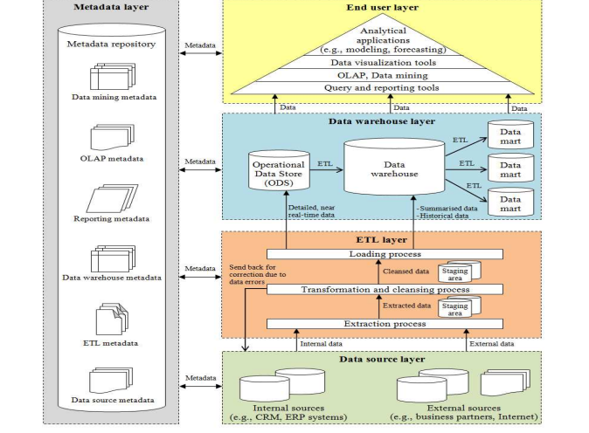

Slide 165
Salability
Scalability is the capability to make a software application available to those who need it and want it.
Scalable applications can help increase user adoption across an organization and may even increase the time users spend engaged in self-service activities.
Scalability makes insights accessible to everyone. Dashboards and reports are available to any number of users, not just restricted to the data analysts or executives in an organization. In fact, many companies are embracing the concept of the extended .
Scalable applications may be easily deployed on the web via .NET and Java application platforms.
Applications can be deployed to any major infrastructure, whether on-premise with end-users, hosted at a data center, or in a cloud-based infrastructure such as Amazon Web Services or Microsoft Azure.

Slide 166
Performance in BI – In Memory Analytics.
In-memory analytics is a business intelligence (BI) methodology used to solve complex and time-sensitive business scenarios.
It works by increasing the speed, performance and reliability when querying data.
In-memory analytics, the queries and data reside in the server's random-access memory (RAM).
In-memory analytics is achieved through the growth and adoption of 64-bit architectures, which can handle more memory and larger files compared to 32-bit–and an overall reduction in the price of memory.
In-memory analytics helps improve the overall speed of a BI system and provides business-intelligence users with faster answers compared to traditional disk-based business intelligence, especially for queries that take a long time to process in a large database.

Slide 167
There are a number of in-memory analytics tools and technologies with different architectures.
The five types of business intelligence in-memory analytics:
In-memory OLAP: Classic MOLAP cube loaded entirely in memory
In-memory ROLAP: ROLAP metadata loaded entirely in memory.
In-memory inverted index: Index, with data, loaded into memory.
In-memory associative index: An array/index with every entity/attribute correlated to every other entity/attribute.
In-memory spreadsheet: Spreadsheet like array loaded entirely into memory

Slide 168
ROLAP, MOLAP AND HOLAP
 | OLTP | OLAP
Types of User | Clerk, IT Professional | Knowledge worker
Function | Day to day operations | Decision support
DB Design | Application-oriented (E-R based) | Subject-oriented (Star, Snowflake)
Data | Current, Isolated | Historical, Consolidated
View | Detailed, Flat relational | Summarized, Multidimensional
Usage | Structured, Repetitive | Ad hoc
Unit of work | Short, Simple transaction | Complex query
Processing Time | Less | More
Data in Tables | Normalized (3NF) | Not Normalized?
Backup | Need regularly | Not needed
Access | Read/Write Mostly | Read Mostly
Operations | Index/hash on prim. Key | Lots of Scans
Records accessed | Tens | Millions
No of Users | Thousands | Hundreds
Db size | 100 MB-GB | 100GB-TB

Slide 169
ROLAP | MOLAP
ROLAP stands for Relational Online Analytical Processing. | MOLAP stands for Multidimensional Online Analytical Processing.
It usually used when data warehouse contains relational data. | It used when data warehouse contains relational as well as non-relational data.
It contains Analytical server. | It contains the MDDB server.
It creates a multidimensional view of data dynamically. | It contains prefabricated data cubes.
It is very easy to implement | It is difficult to implement.
It has a high response time | It has less response time due to prefabricated cubes.
It requires less amount of memory. | It requires a large amount of memory.

Slide 170
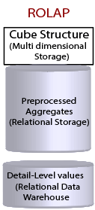
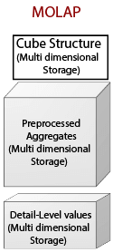

Slide 171
Chapter 6: Technologies Enabling Presentation

Slide 172
Introduction
Importance of presentation capability of BI
Technologies that support decision making
Tactical decisions
Strategic decisions
Online analytical processing (OLAP)
Visual analytics
Performance dashboards

Slide 173
Online Analytical Processing
Transactional databases are accessed by online transaction processing (OLTP) applications
OLAP was coined by Edgar Codd [1970 ]
OLAP is used essentially to query the DW
OLAP supports the presentation of data in a multi-dimensional format called a cube
The numeric facts in the DW known as the measures

Slide 174
OLAP Cubes
OLAP offers the ability to have more than three dimensions (hypercube)
Pivot Table – A data summarization tool
OLAP cubes enable slicing and dicing the data

Slide 175
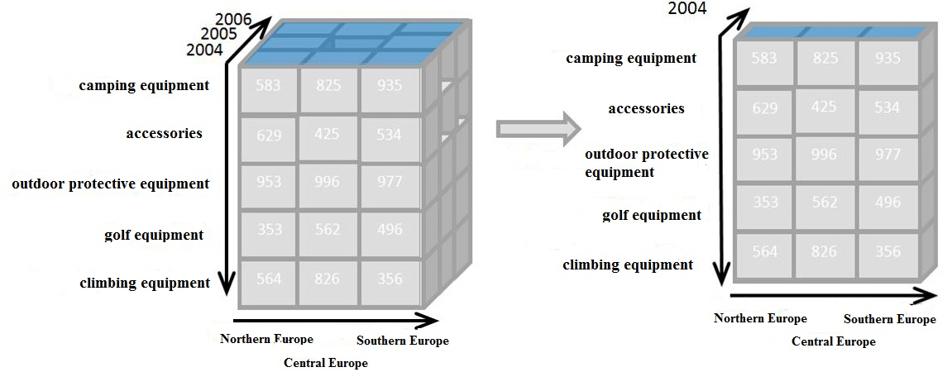
OLAP Cube, Data Slice and Dice

Slide 176
Visual Analytics
Visual analytics refers to the use of computer graphics to create a visual representation of large collections of information
Purpose of visualization is to enable knowledge discovery
Importance: visualization helps users see patterns
Example: study of a hurricane

Slide 177
BI in Practice: The Need for BI for Visual Analytics in Emergency Response
National Visualization and Analytics Center, located at the Pacific Northwest National Lab, supports the US Dept. of Homeland Security
The science of analytical reasoning
Visual representation and interaction technologies
Data representations and transformations
Production, presentation, and dissemination
Privacy and security issues that are based on an interoperable architecture

Slide 178
BI in Practice: Improving Sales Performance via Visual Business Intelligence
Field sales representatives’ organizational structures
Example: for those working in pharmaceutical and healthcare businesses
Visual information mapping tools are helpful to build these sales structures
Using color coding to map the sales territories offers several advantages
Visual information mapping tools may also allow combining and integrating different values associated with operational parameters to create ‘balanced’ territories

Slide 179
Performance Dashboards
Performance dashboards are designed to be similar to a car dashboard
Performance dashboards serve as an “organization magnifying glass”
Measure performance, reward positive contributions and align efforts
Used for forecasting, inventory, production and sales
Organizational performance- “Three Threes”

Slide 180
Performance Dashboards
Three applications: a monitoring application, an analysis application, and a management application
Three layers: integrates a monitoring layer, an analysis layer, and a detailed information layer
Three types: support operational, tactical or strategic decision-making

Slide 181
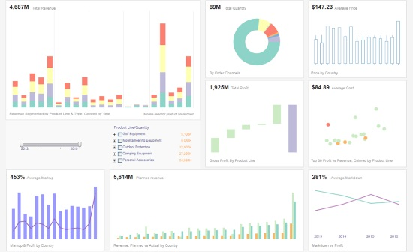
Performance Dashboard

Slide 182
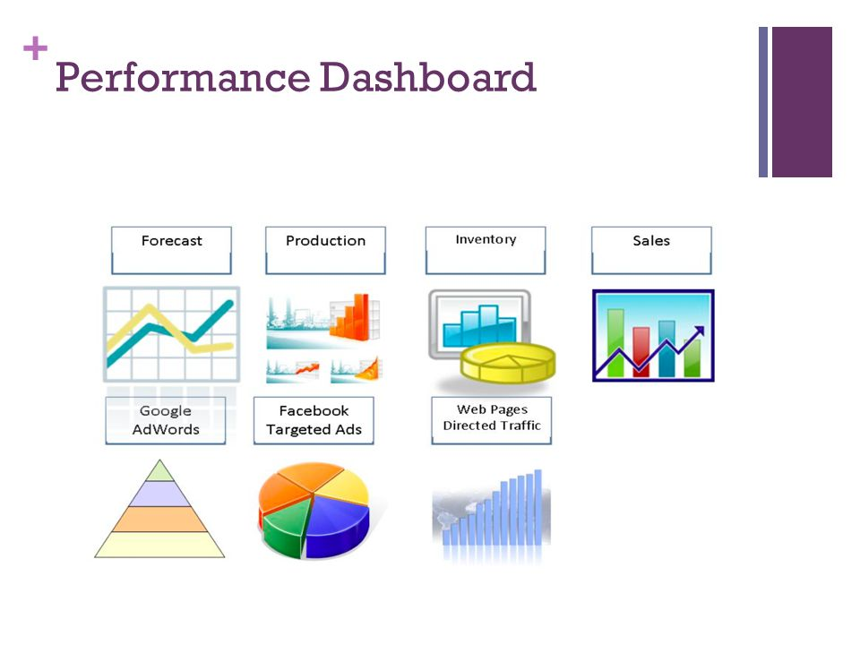

Slide 183
Balanced Scorecards
Monitor and show performance by focusing on certain outcome metrics and comparing them to a target
Monitor tactical and strategic goals
Balanced Scorecard
Focuses on four organizational perspectives:
Financial
Customer
Internal business process
Learning and growth

Slide 184
Balanced Scorecards
Approach for organizational assessment developed by Kaplan and Norton
Firm’s competitiveness
Quantify the intangible assets of an organization
Measure past performance
Internal processes and intangible assets
Measures value creation for the organization

Slide 185
Balanced Scorecards
Organizations can use the balanced scorecard as a means to link their long-term strategic objectives with their short term actions through four management processes.
Translating the vision
Communicating and linking
Business planning
Feedback and learning

Slide 186
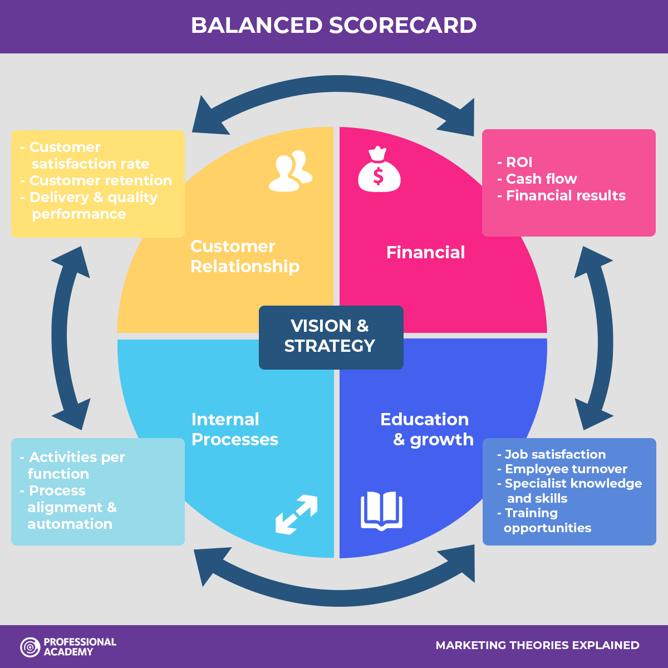
Balanced Scorecards

Slide 187
Vision Statement
Our vision is to be internationally-recognized for providing a high-quality, technology-enabled educational experience rooted in our Miami location and focused on the unique requirements of doing business in a global and interconnected market.
Core Values
Excellence: We pursue excellence in all we do and nurture this pursuit in others.
Ethics: We are committed to doing the right thing in both our words and deeds.
Professionalism: We hold ourselves to the highest standards of expertise and of professional conduct.
Innovation: We embrace change, uncommon thinking, creativity, and the entrepreneurial spirit.
Collegiality: In working together, we respect each other and welcome diverse viewpoints.
Mission Statement
Our mission is to create enduring educational value for our students, for our alumni, and for the business, professional, and academic communities we serve:
•For our students-whom we prepare to succeed in a rapidly changing, technology-driven global business environment;
•For our alumni-to whom we provide opportunities for continuing professional development and a legacy that appreciates as our excellence grows;
•For the business and professional communities-to whom we offer knowledgeable graduates, educational programs, research, and collaborative projects;
•For the academic community-to whom we bring new knowledge by creating an environment that nurtures high-quality research and the development of future scholars.
Goals and Objectives
Strategic Priorities
1. Maintenance of Accreditation
2. Focus - Build excellence and international recognition through investments in programs and faculty in the areas of international business, entrepreneurship, and professional services – accounting, finance, real estate, and insurance.
3. Program Portfolio – Continually evaluate portfolios of programs to ensure excellence in teaching and learning and market need.
4. Growth and Quality - Increase quality of undergraduate students while maintaining current enrollment, grow graduate enrollment by 50% over next 5 years while increasing quality of admitted students.
5. Faculty – Recruit, develop and support an outstanding faculty.
6. Funding – Acquire needed funds to support the college’s mission.
7. Space – Complete construction of Phase II of the Business School Complex.
Strategic Initiatives 2008-2009
1.Maintenance of Accreditation: Implement review recommendations.
2.Undergraduate Programs: Continue implementation of Assurance of Learning System and enhanced undergraduate career services.
3.Graduate Programs: Complete scheduled program reviews and implement recommended changes.
4.Faculty: Recruit replacements for faculty members who resign or retire and recruit new incremental faculty members.
5.External Relations: Expand membership on our advisory boards and our community involvement.
6.External Visibility: Maintain rankings.
7.Internal Processes: Maintain technology for new School of Business Complex.
8.Revenue Generation: Secure private funding for faculty support, student support, and the building; grow executive and professional education program; and plan for new value-added programs.
Core Competencies and Definition of Metrics
(L)earning, Instruction, and Student Services - Provide educational programs and learning experiences that prepare individuals to make sustained contributions to organizations and society in a global environment and are recognized for excellence. Deliver outstanding student services.
(R)search and Scholarship - Identify and address important business and economic issues through discovery, application, and dissemination of knowledge.
(S)ervice and Outreach - Offer expertise to government agencies, business and professional organizations, and others, to promote economic development and to provide value-added educational and professional programs.
(E)xternal Relations and Development - Enhance opportunities for mutually beneficial collaboration between the College and its constituents and grow private investments in the College.
(P)eople - Attract, develop, and retain highly qualified faculty and staff.
(I)nternal Operations - Cultivate an efficient and effective operation that enables faculty and staff to achieve the mission of the College.
Key Metrics
Undergraduate Programs
L1. Assurance of Learning Outcomes
L2. Use and Manage Technology Outcome
L3. Quality of Students
L4. Student Recognitions
L5. Head Count - # of Graduates
L6. FTE enrollment - % of Enrollment Targets Met
L7. Placement – Satisfaction and Outcomes
L8. Satisfaction with Advising
L9. Quality of Instruction
L10. Expectations Met
L11. Rankings
Graduate Programs
L12. Assurance of Learning
L13. Quality of Students
L14. FTE enrollment - % Enrollment Target Met
L15. Placement – Satisfaction and Outcomes
L16. Expectations Met
L17. Rankings
_____________________________________________
R1. Publications in Premier Journals
R2. Citations in Social Service Index
R3. Editorial Board Membership
R4. Recognition and Awards
_____________________________________________
S1. Revenues from EPE Programs
S2. Participation on Boards
_____________________________________________
E1. Corporate Community Participating in Advisory
Boards
E2. Membership in Business Alumni Chapter
E3. New Private and Corporate Donations
________________________________________
P1. Adequacy and Quality of Faculty
P2. Professional Development Support of Faculty and Staff
_____________________________________________
I1. Technology Availability and Quality
I2. User Satisfaction and Use of Technology Resources

Slide 188
IT Governance
IT governance refers to “specifying the decision rights and accountability framework to encourage desirable behavior in the use of IT”
Goal: determine who makes the key IT decisions in the organization and how
Effective IT governance is the single most important predictor of value an organization generates from IT
IT Principles – a related set of high-level statements about how IT is used in business

Slide 189
IT Governance
IT Architecture
IT Infrastructure
Business Applications Needs
IT Investment and Prioritization
Communications Mechanisms

Slide 190
BI in Practice: Achieving IT Value Through Balanced Scorecards
Implementing the use of Balanced Scorecards in the organization
Important steps to ensure their success are:
Preparing the organization for change
Devising the right metrics
Getting buy-in from employees at all levels
Following through the implementation plan

Slide 191
BI in Practice: Achieving IT Value Through Balanced Scorecards
Identifying four or five value drivers
Organization should appoint a champion, someone who typically oversees the IT budget
Companies that have been able to capitalize on their successful balanced scorecard deployments include Exxon Mobil and Cigna Insurance.

Slide 192
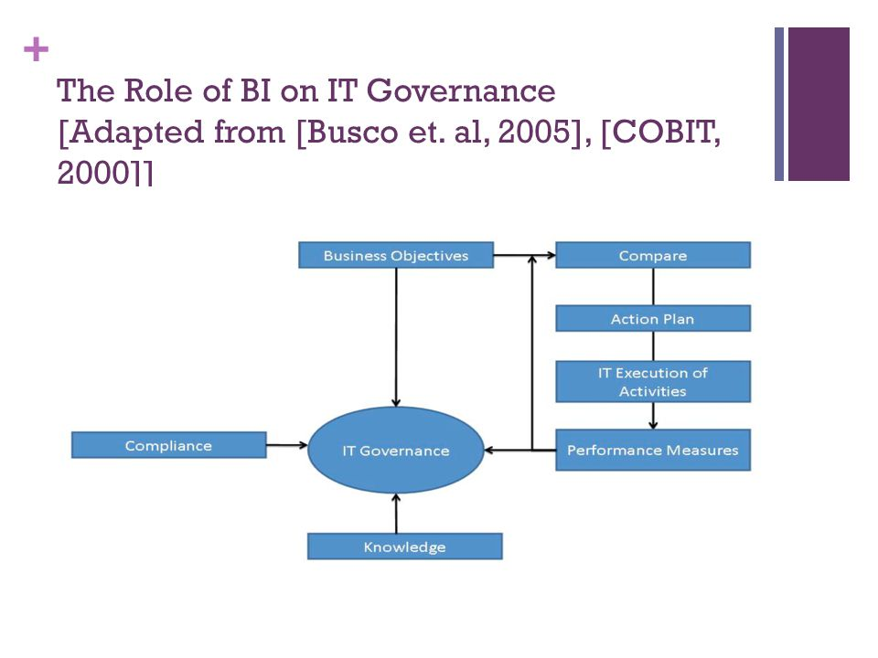
The Role of BI on IT Governance [Adapted from [Busco et. al, 2005], [COBIT, 2000]]

Slide 193
Impact of BI on Corporate Performance
Infrastructure for members of the organization to measure, monitor, and manage the key activities and processes that the organization must pursue in order to meet their goals, or their key performance indicators (KPIs)
The goal – to provide decision-makers with the following capabilities:
Detect events
Prompt managers
Analyze data in real time
Collect data

Slide 194
Impact of BI on Corporate Performance
When designing performance dashboards for the organization it’s important to avoid ten common mistakes:
Failure to apply the “Three-Threes”, of three applications, three layers, and three types
Overrating the importance of dashboards and scorecards
Failing to deliver three applications: Access, Analyze, and Management
Failing to deliver three layers
Failing to create the right type of performance dashboard:
Operational metrics
Tactical metrics
Strategic metrics

Slide 195
Impact of BI on Corporate Performance
Falling prey to glitz
Building a dashboard with a lightweight architecture
Delivering real-time data without context
Failing to design effective KPIs
Failing to apply KPIs correctly

Slide 196
Impact of BI on Corporate Performance
BI can support the implementation of dashboards and scorecards for the creation of KPIs that enable the organization to:
Communicate and refine their business strategy
Increase visibility of the organization’s strategic goals
Increase enterprise-wide coordination of activities
Increased motivation, morale and empowered users
Provide a consistent view of the business

Slide 197
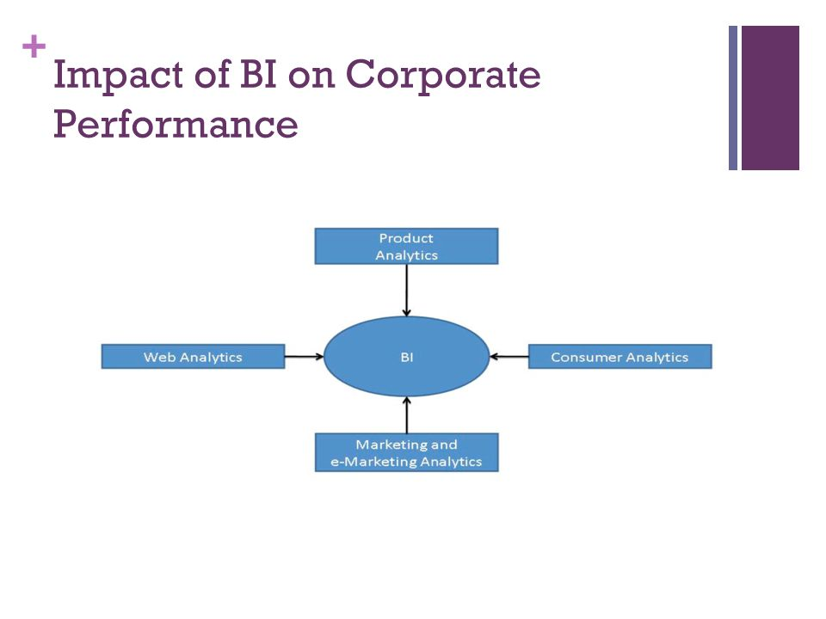
Impact of BI on Corporate Performance

Slide 198
Case Study: Designing Vigilant Information Systems with Real-Time Dashboards
Western Digital (WD), a US $3 Billion designer and manufacturer of high-performance hard drives
WD relied on multiple sources of data, ERP reports often produced different results
Essence management lacked the necessary information to quickly respond to the business needs
Vigilant Information Systems (VIS) - system initiates the process (versus the user), and the database is active (versus passive)
VIS must fulfill the following four capabilities, known as the OODA loop :
Observing
Orienting
Deciding
Acting

Slide 199
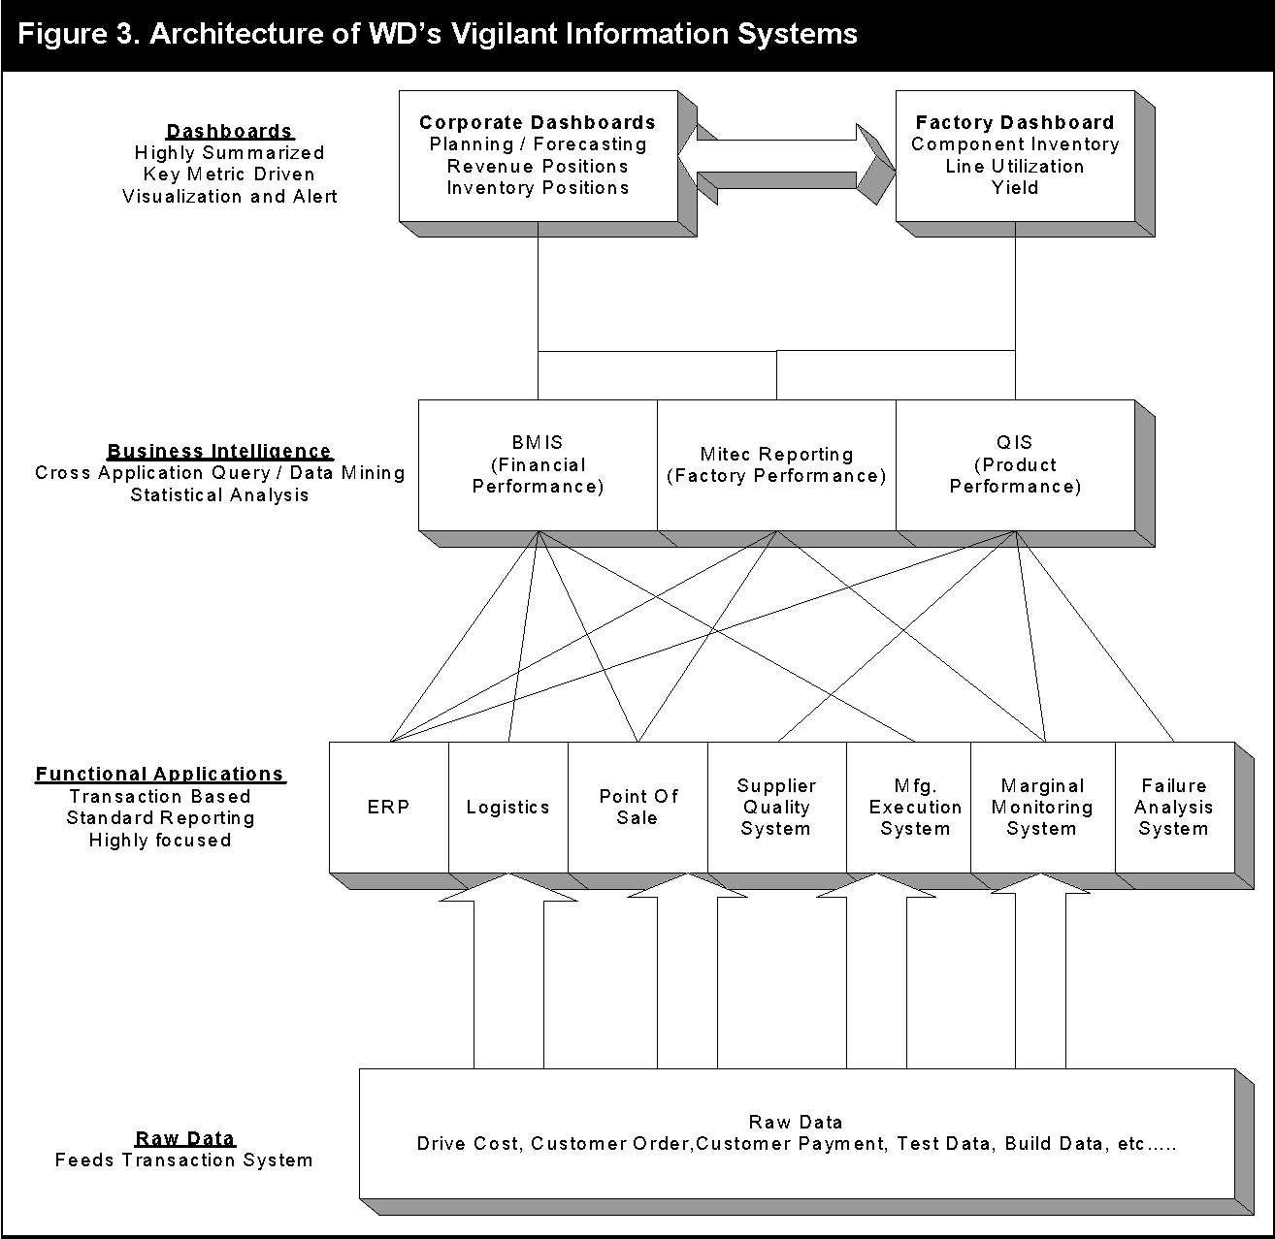
Architecture of WD’s Vigilant Information Systems

Slide 200
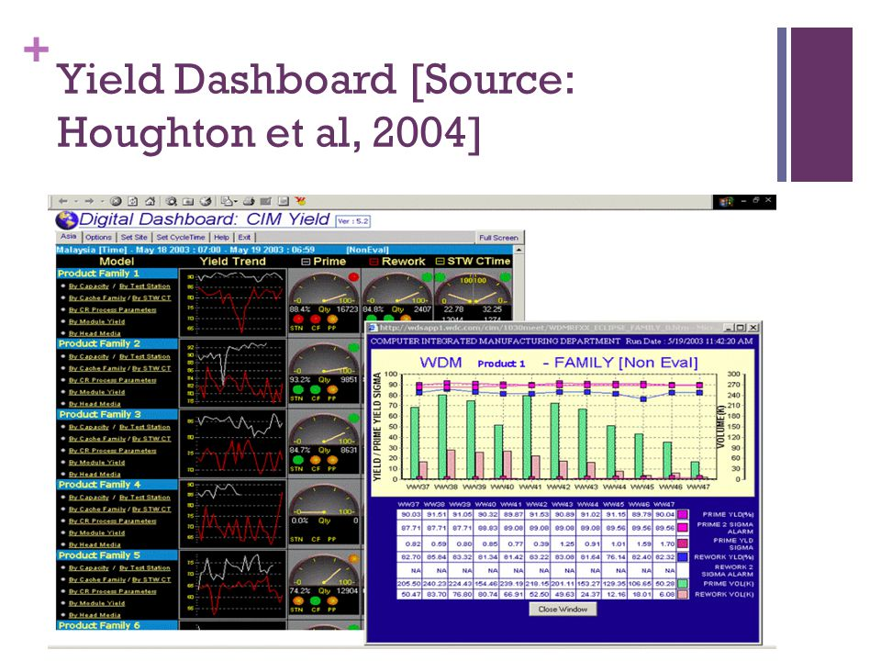
Yield Dashboard [Source: Houghton et al, 2004]

Slide 201
Case Study: Designing Vigilant Information Systems with Real-Time Dashboards
The implementation of the VIS at WD demonstrated seven lessons :
Design the VIS as the ‘nerve-center’ for managing the enterprise
The VIS can serve as the basis for team coordination across the enterprise
The VIS ‘OODA’ loops can foster organizational learning across the enterprise
Real-time in the VIS should match the organization’s ability to respond, zero latency is not always the goal
VIS can provide the infrastructure for an organization’s ability to sense-and-respond
Investment in VIS should be justified not only by return-on-investment, but also on the impact of not having them
VIS implementations should not be a technology initiative, but instead a management initiative supported by the leadership of the enterprise

Slide 202
Case Study: Designing Vigilant Information Systems with Real-Time Dashboards
Real-time management performance dashboards can fall into one of the four categories shown in Figure
EIS Business Performance Dashboards
Operations Control Dashboards
Business Process Dashboards
Collaborative Dashboards

